Slide 1
Lo: Can I learn why Jewish families celebrate Shabbat?
Last time we learned about the celebration of Shabbat which is celebrated by many Jewish families.
Can you recall 3 things about the celebration?
What do the family do to prepare?
Who lights the candles on the table?
What do the family stop doing?
Answers on the next page!

Slide 2
Answers
1.Clean the house
2. Mum lights the candles
3 The family don’t do go to work or do homework

Slide 3
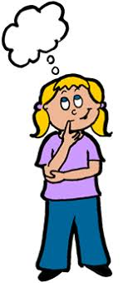
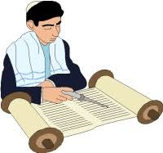
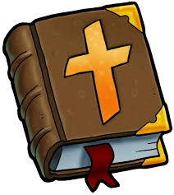
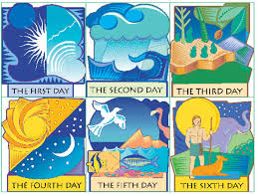
Now let’s think about why Jewish families celebrate Shabbat.
Jews are thinking about a story that is in the Jewish holy book, called the Torah
This story can also be found in the Christian Bible. It is the very first story in the Bible.
Can you think what story it is?
Yes , it is the story of Creation!
Both Christians and Jews believe in the story of Creation.
What can you remember about the story of Creation?
Can you say who they believe created the world?
Can you remember how many days it took to create the world?
What did God do after he had finished his work?
Answers on the next page!

Slide 4
Answers
1. Christians and Jews believe God created the world
2. 6 days plus more for a rest day
3 He rested
On the next page is some more information.
Ask an adult to read it with you.

Slide 5
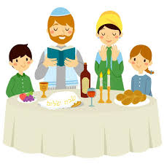
When Jewish families stop and have a rest they are remembering the Creation story .
God worked all through the days , and stopped to rest.
Jewish families work all the week , and stop to have a rest.
Because it is such an important story , Jewish families like to spend this time together , to celebrate the wonderful world , being together and to say Thank you to God for his creation, and everything he has provided.
It is a lovely time when sharing a family time together to feel peaceful and restful.
It is a time in the week that families enjoy together and it is a special time to look forward to.
Everyone is happy because work has ended for the week and they can relax together and say thanks to God for all the good things in life.
As they share the challah bread they think about the wonderful things God has created for them.

Slide 6
So let’s think what have we learned so far about Shabbat
It is a time when Jewish families remember the story of God’s creation,
when he created the world and then had a rest.
It happens every week. The special meal is on Friday.
It is a time at the end of a busy week, when Jewish families stop their work.
They sit and have a special meal together, and enjoy a rest.
Before the meal , everyone helps to tidy up and get ready . The table is laid with 2 candles
and special bread called Challah.
Everyone has a drink , the grown ups have wine and the children have grape juice.
They say blessing together, to say thank you to God.
Everyone takes part, and everyone feels they belong.
You can watch the video clip again here … Introduction to Shabbat https://www.bbc.co.uk/bitesize/clips/zs2hyrd
before your activity on the next page.

Slide 7
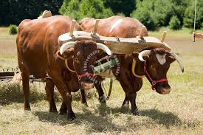
Jewish families believe that God wants humans to care for the world
and everything in it
Here are some Jewish rules for animals.
These rules come from the Jewish Holy book , the Torah. Jewish families try to
follow the rules.
Do not muzzle the ox while he threshes the grain.
It is not right to show an animal a lot of food and not allow him to eat it.
If you meet your enemy's ox or his donkey wandering away,
you shall surely return it to him
On the Sabbath when people rest from work they should let their work animals rest too.
If you have to kill an animal for food you should be as gentle as you can.
Talk about what the rules means. Can you decide some important rules that you think humans should follow to care for the world ? Talk about them with your family.

