Slide 2
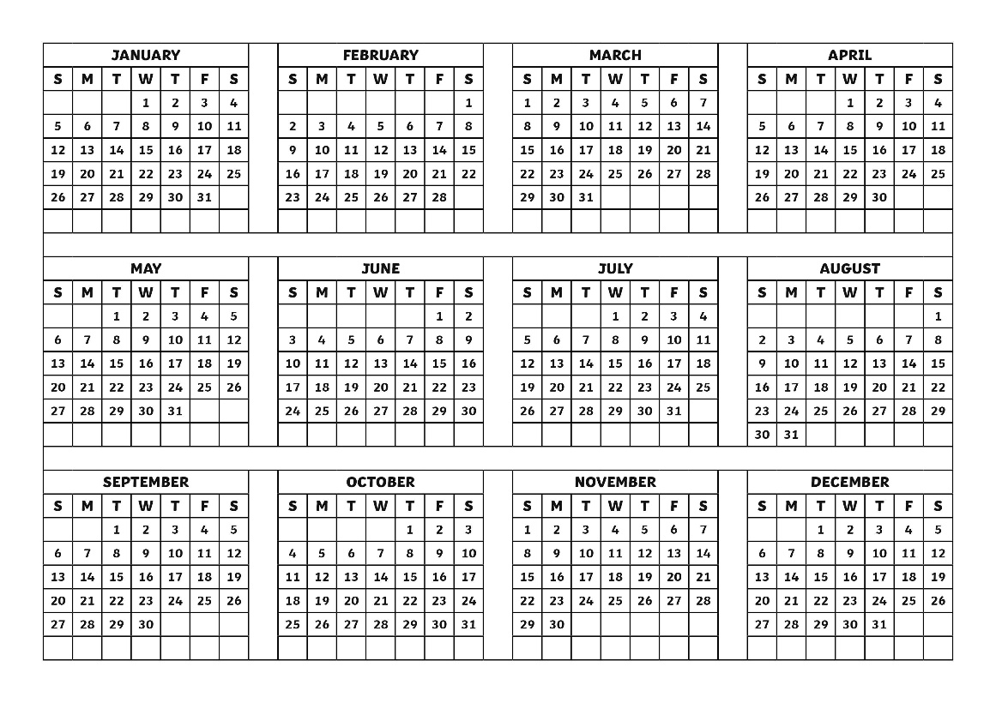
Months of the Year
Each year has 365 or 366 days. These days are grouped into months.
There are 12 months in a year.

Slide 3
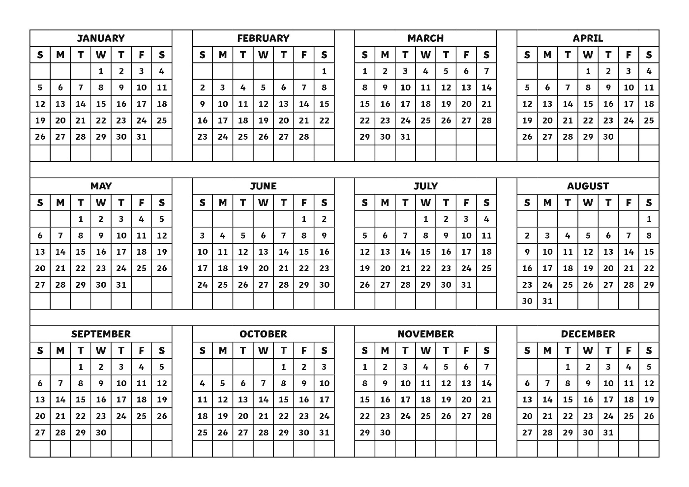
Months of the Year
Each month has 28, 29, 30, or 31 days.

Slide 4
January
January is the first month of the year.
January begins on New Year’s Day.
January has 31 days.
January’s abbreviation is Jan.
January’s month number is 1.

Slide 5
February
February is the second month of the year.
February usually has 28 days. Every four years, in a leap year, it has 29 days.
February’s abbreviation is Feb.
February’s month number is 2.
Saint Valentine’s Day is on February 14th.

Slide 6
March
March is the third month of the year.
March has 31 days.
March’s abbreviation is Mar.
March’s month number is 3.
Saint Patrick’s Day is on March 17th.

Slide 7
April
April is the fourth month of the year.
April has 30 days.
April’s abbreviation is Apr.
April’s month number is 4.
April is during springtime.

Slide 8
May
May is the fifth month of the year.
May has 31 days.
May’s abbreviation is its own name, May.
May’s month number is 5.
Mother’s Day is in May.

Slide 9
June
June is the sixth month of the year.
June has 30 days.
June’s abbreviation is Jun.
June’s month number is 6.
Summer begins in June.

Slide 10
July
July is the seventh month of the year.
July has 31 days.
July’s abbreviation is Jul.
July’s month number is 7.
The Fourth of July is in July.

Slide 11
August
August is the eighth month of the year.
August has 31 days.
August’s abbreviation is Aug.
August’s month number is 8.
August is the last summer month.

Slide 12
September
September is the ninth month of the year.
September has 30 days.
September’s abbreviation is Sep.
September’s month number is 9.
Many students begin school in September.

Slide 13
October
October is the tenth month of the year.
October has 31 days.
October’s abbreviation is Oct.
October’s month number is 10.
Halloween is on the last day of October.

Slide 14
November
November is the eleventh month of the year.
November has 30 days.
November’s abbreviation is Nov.
November’s month number is 11.
Thanksgiving is in November.

Slide 15
December
December is twelfth and last month of the year.
December has 31 days.
December’s abbreviation is Dec.
December’s month number is 12.
Many holidays are in December including Hanukkah, Christmas, and Kwanzaa.

